Slide 1
Stats 240 Final Presentation
Group 6: Andrew, Ami, Indu

Slide 2
Introduction
We were interested in how much is being done to combat the growing housing shortage especially for low income families.
We set out to find data that compared the number of low income households to the number of middle income households that are being produced in a refined area.
We found our data set on NYC Open Data which allowed us to test our hypothesis on New York City.
The dataset included all the housing projects that were produced in New York City since 2014 and were classified by income class.

Slide 3
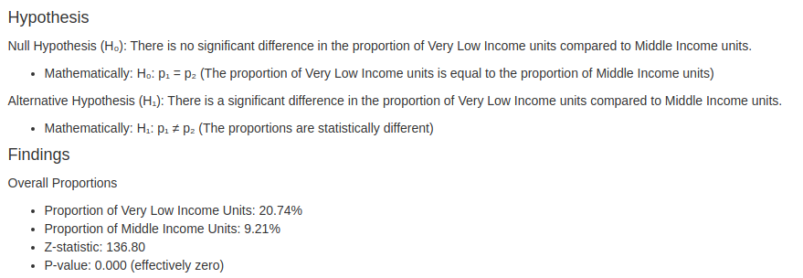
Statistical Testing

Slide 4
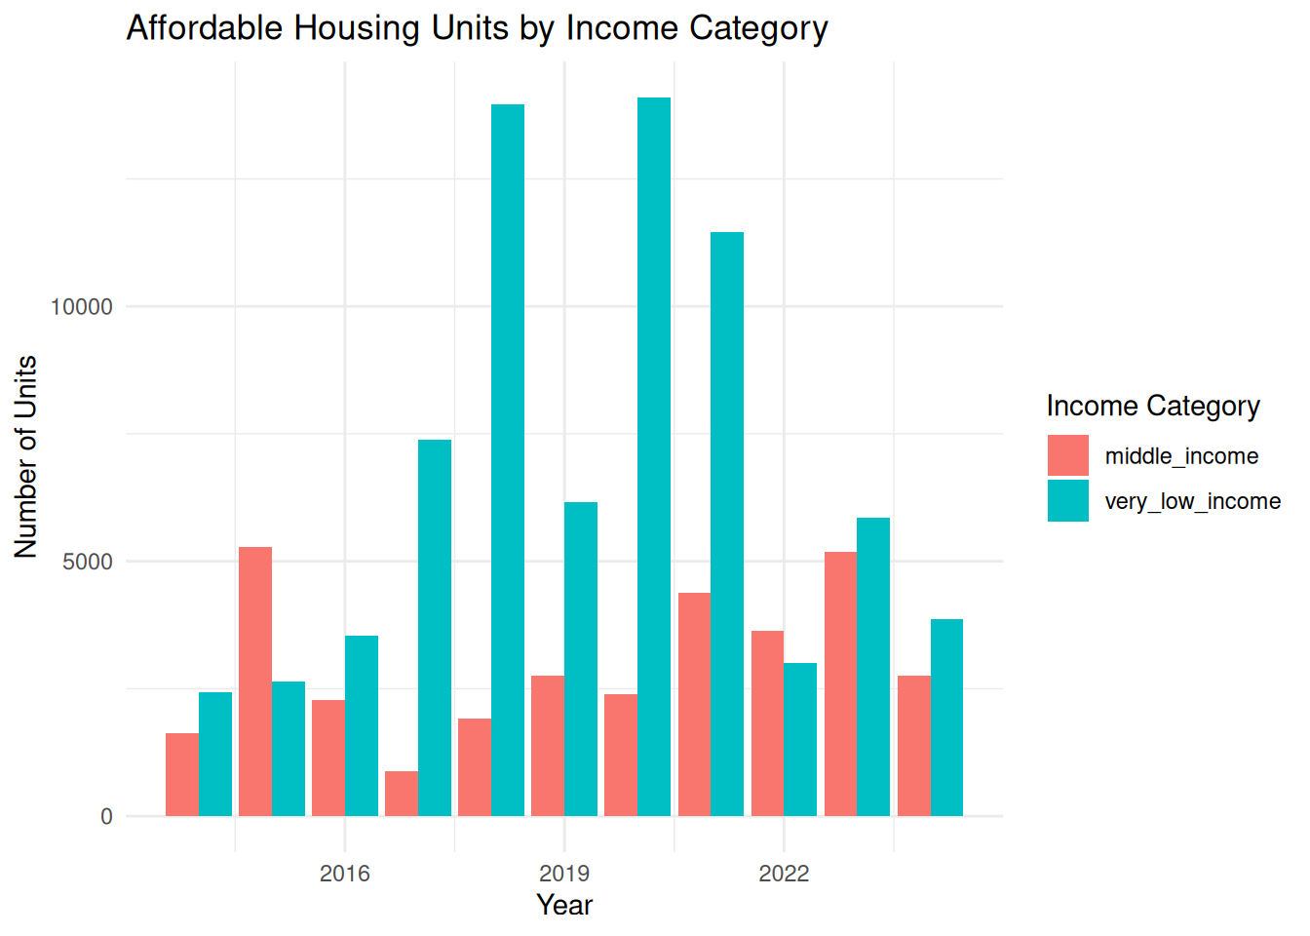
Statistical Testing

Slide 5
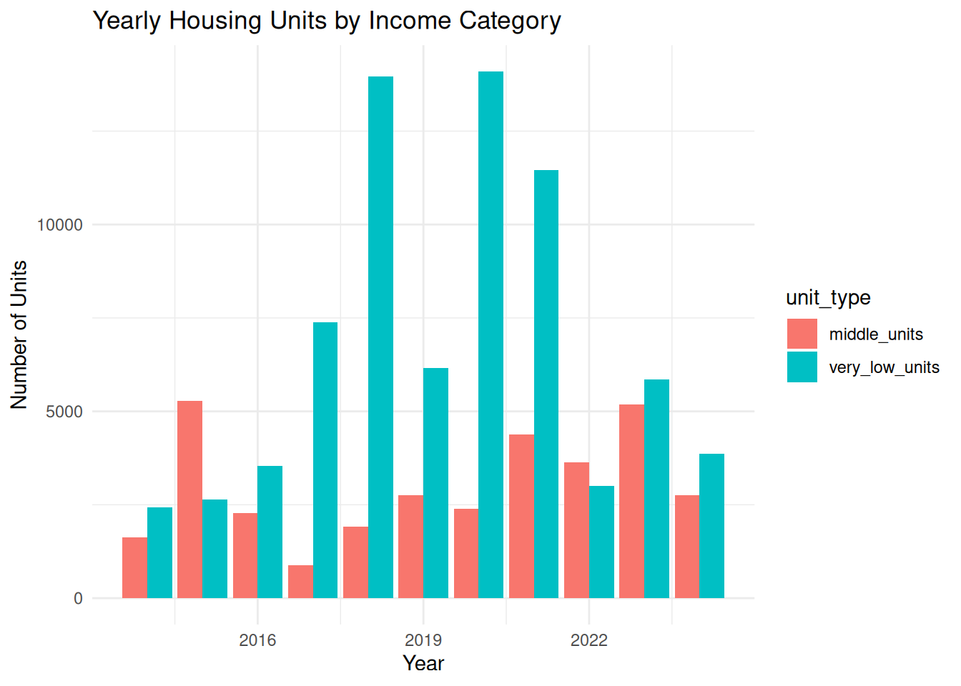
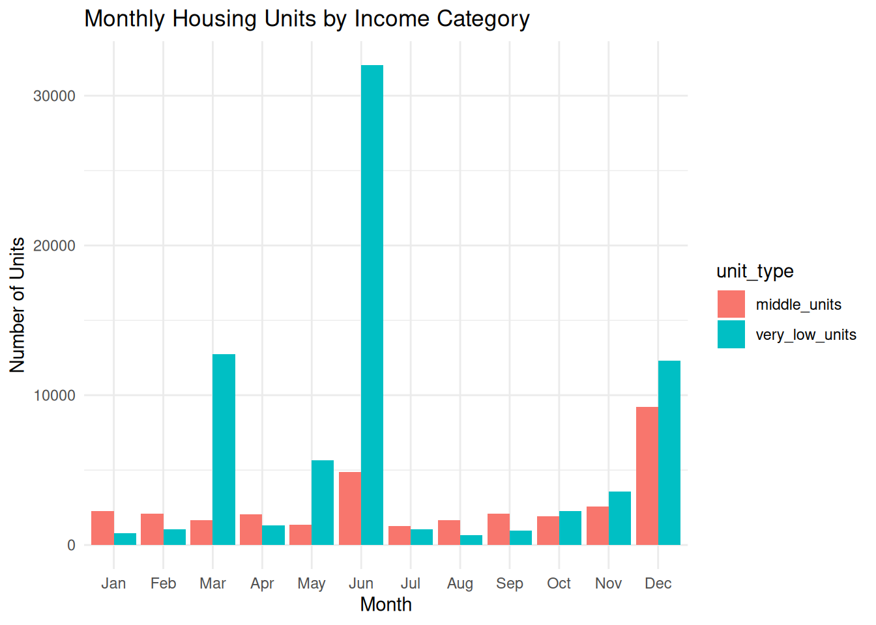
Statistical Testing

Slide 6
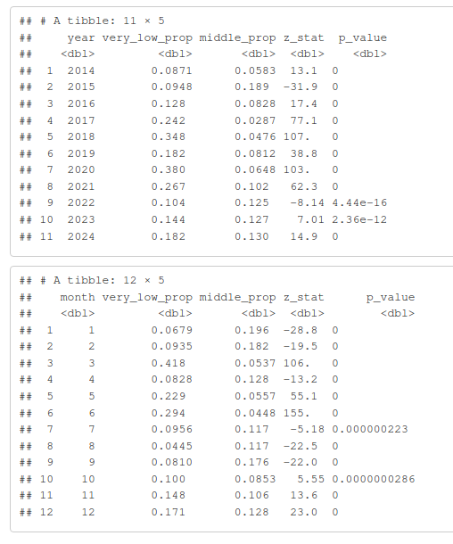
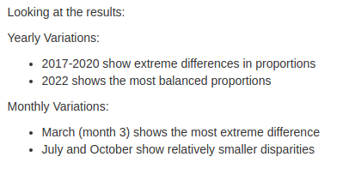
Statistical Testing

Slide 7
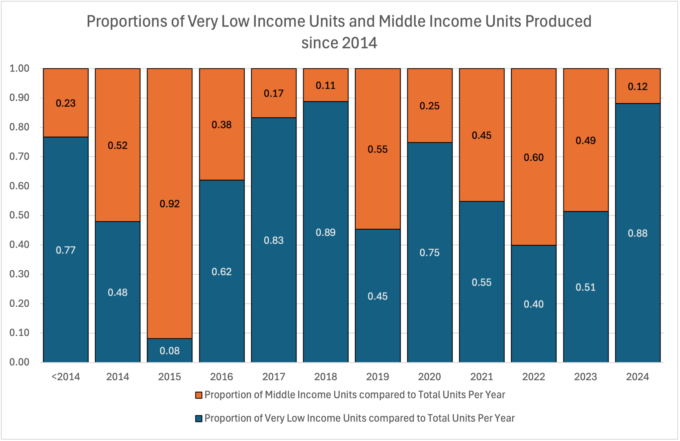
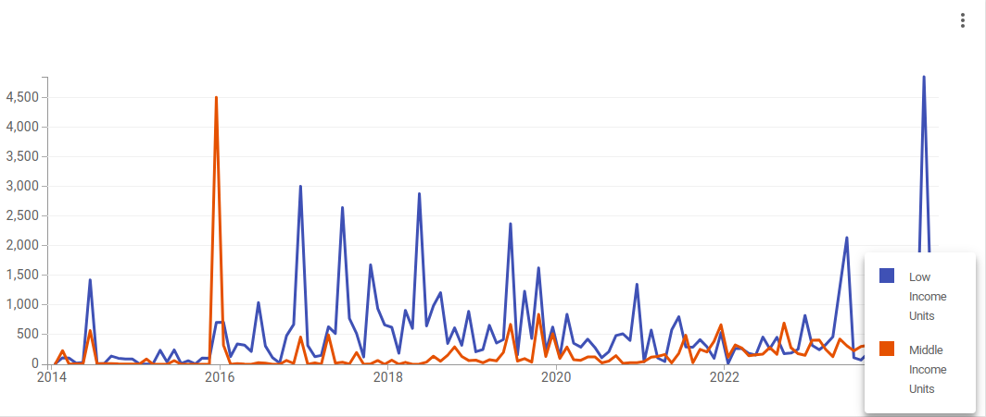
Statistical Analysis
After finding a p-value of nearly 0 we made visualizations to show that in the majority of years there is a greater proportion of low-income housing that is produced compared to that of middle income housing,
Answering our question that from the data it seems like there is something being done to help low-income families when it comes to housing.

Slide 8
Discussion
Short-comings
There wasn’t any information about total housing demand for each income category.
There was also missing data on actual occupancy rates versus just unit construction.
Additional Questions
How many people from each income category obtain and retain these housing units housing?
How do these numbers compare to other major cities?

Slide 9
Questions?

